Slide 1
Tiered app
By Carlos Gerez, Christopher Ditto , and Mark Riley Slik

Slide 2
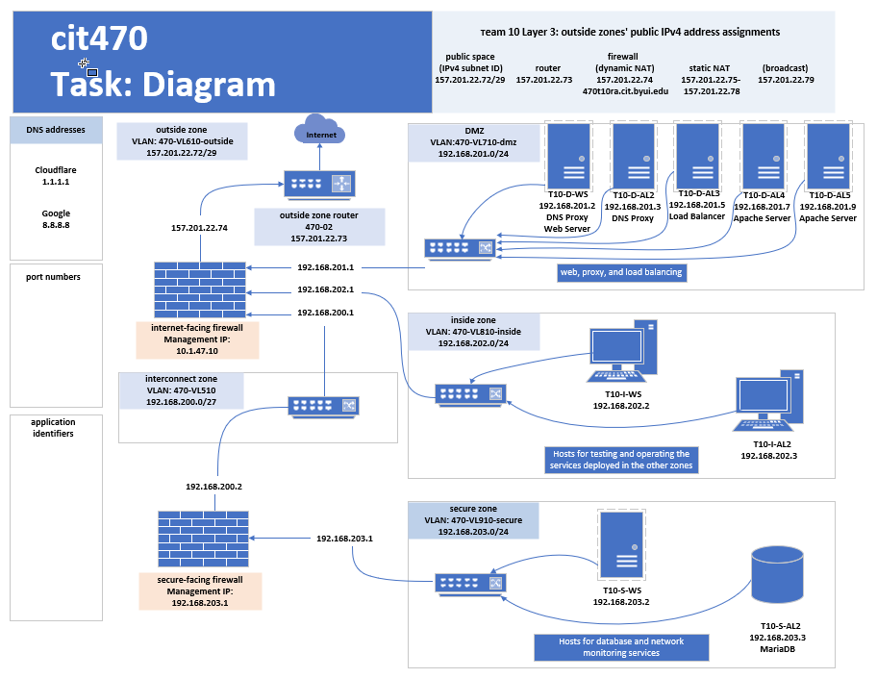
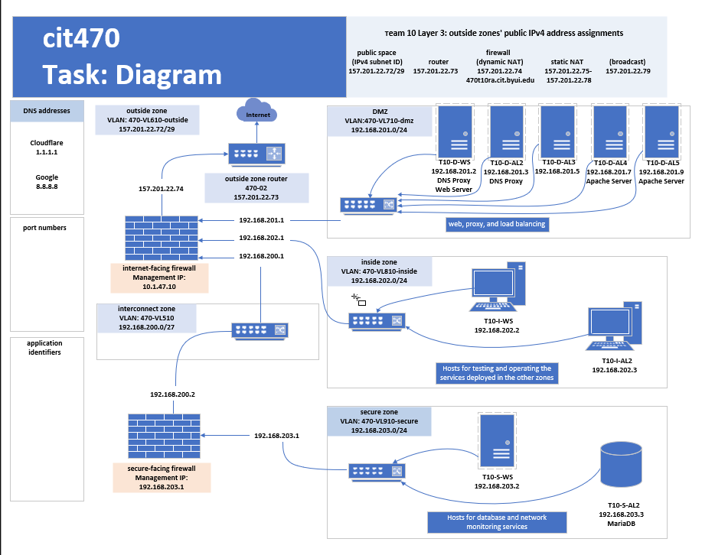

Slide 3
Mariadb installation

Slide 4
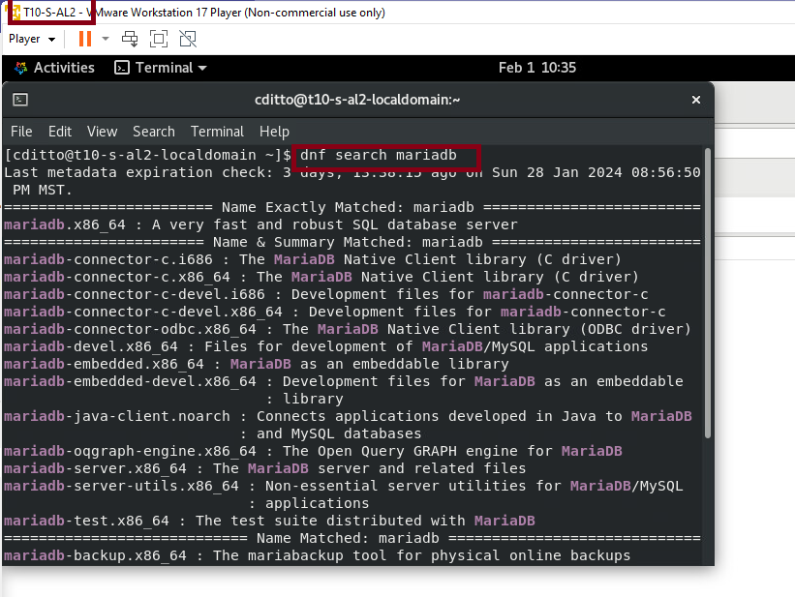
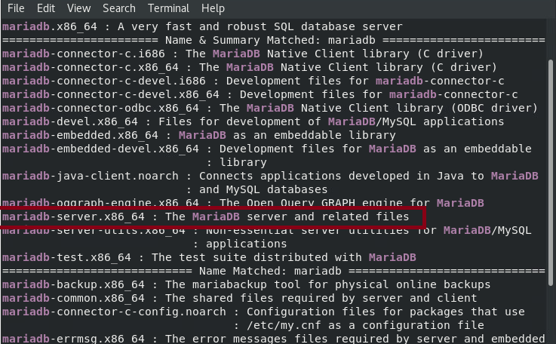
First search to see what options we have as mariadb. Mariadb-server is the one we will use.
dnf search mariadb

Slide 5
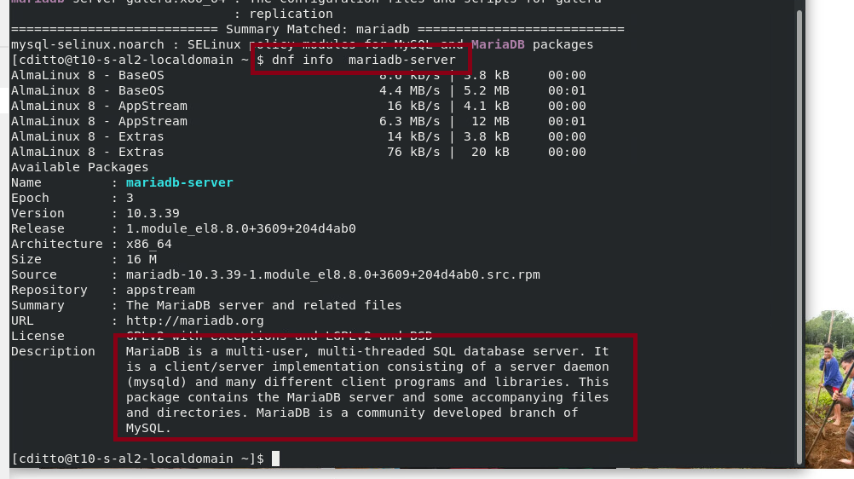
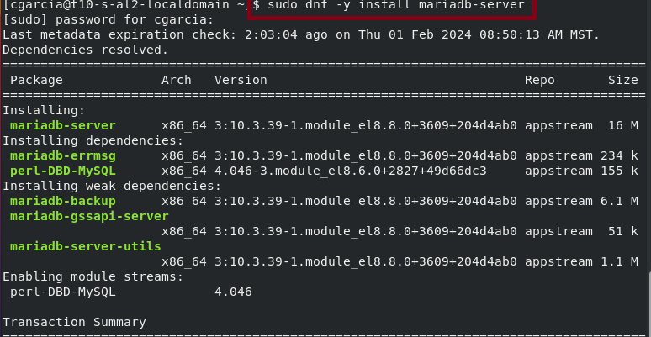
We can see his info and in the second command install it.
dnf info mariadb
sudo dnf -y install mariadb-server

Slide 6
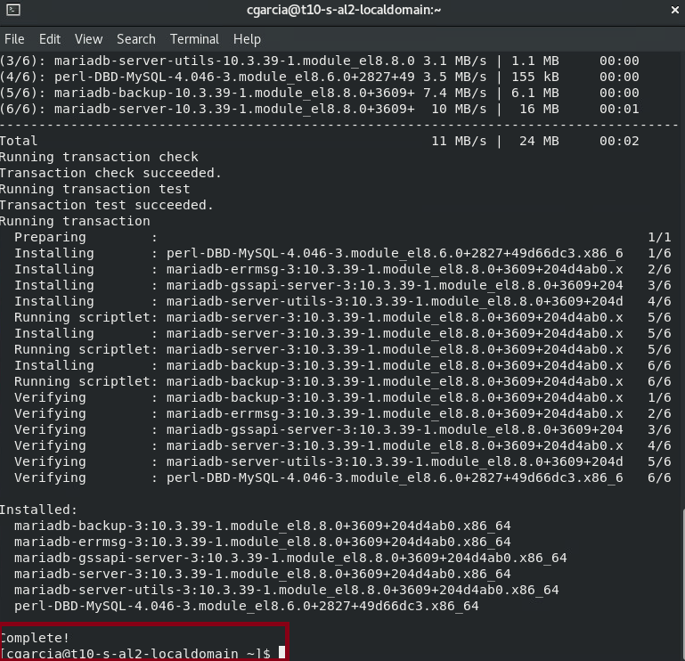
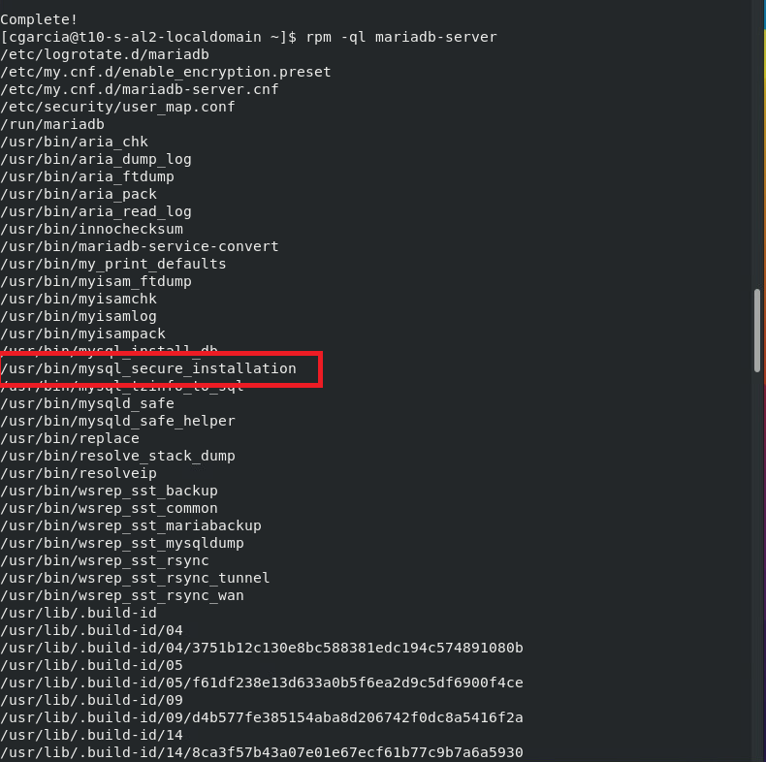
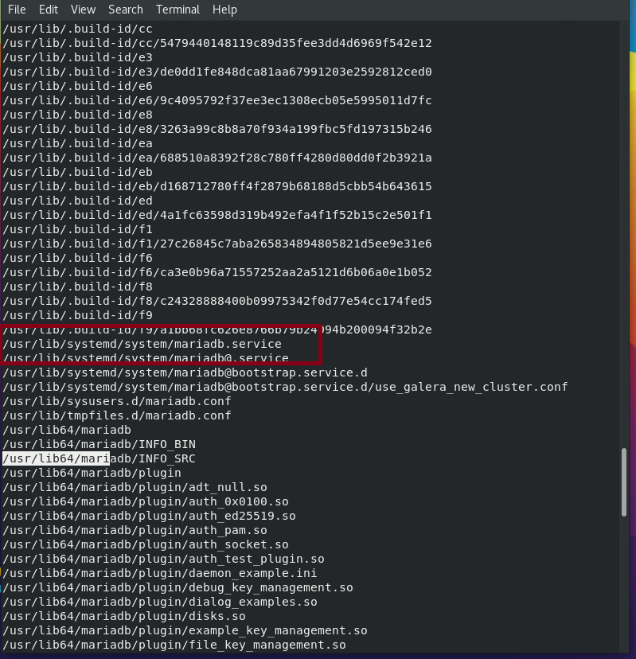
Installation is complete, check for the following files in mariadb package using rpm -ql mariadb-server
/usr/lib/systemd/system/mariadb.service
/user/bin/mysql_secure_installation

Slide 7
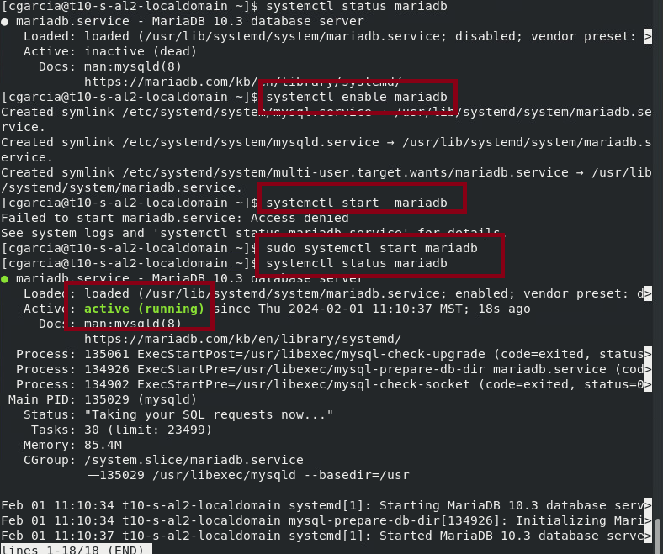
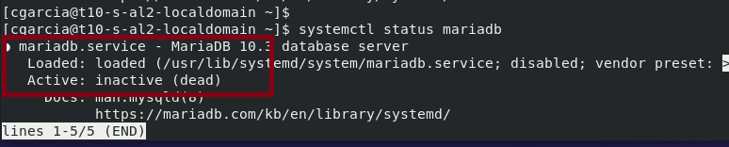
Check status and enable/start the service
Use:
systemctl status mariadb
sudo systemctl enable mariadb
sudo systemctl start mariadb

Slide 8
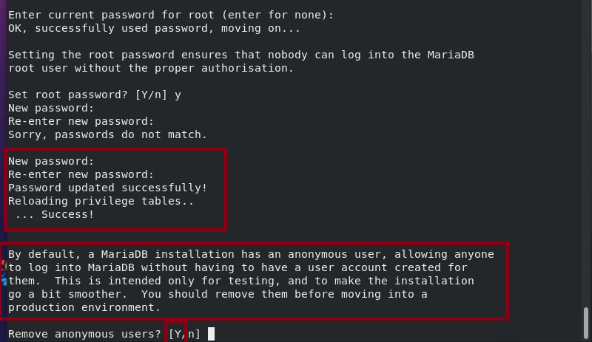
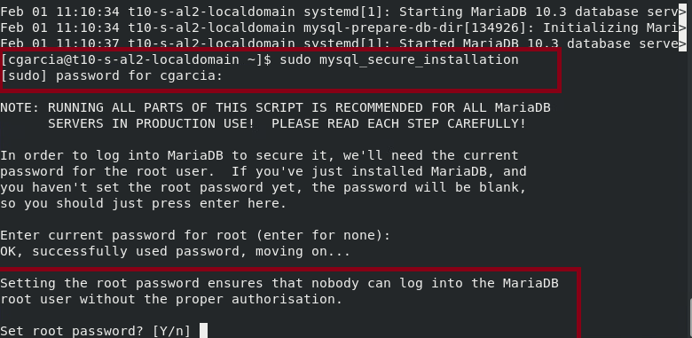
Use my_sql_secure installation to initialize security settings:
sudo mysql_secure_installation
Answer the prompts from the interactive script.

Slide 9
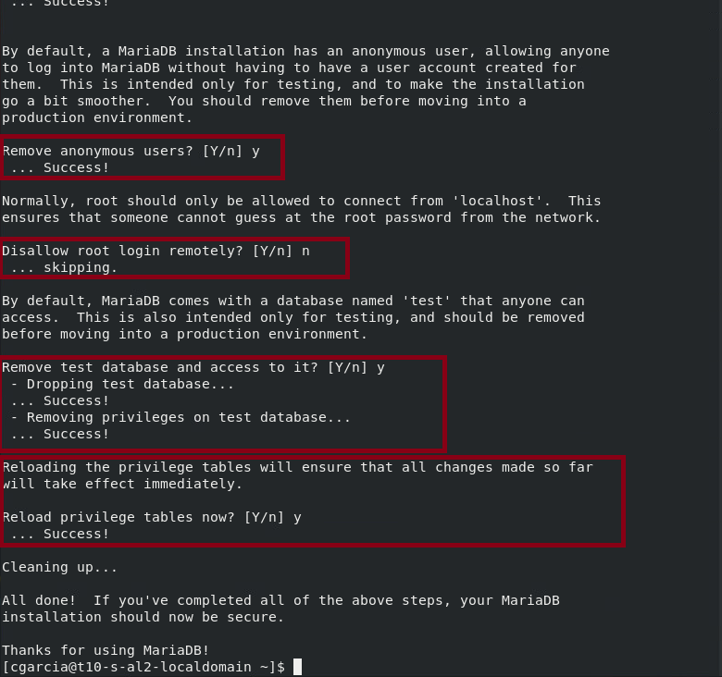
Use my_sql_secure installation to initialize security settings:
Answer the prompts from the interactive script.

Slide 10
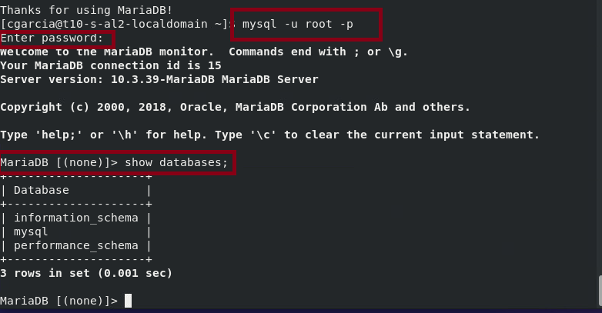
Connect to the database server with the MariaDB root account. (The necessary -p command-line option tells the client to [p]rompt you for the password.)
mysql -u root -p
List the available databases, remember the “;” :
show databases;

Slide 11
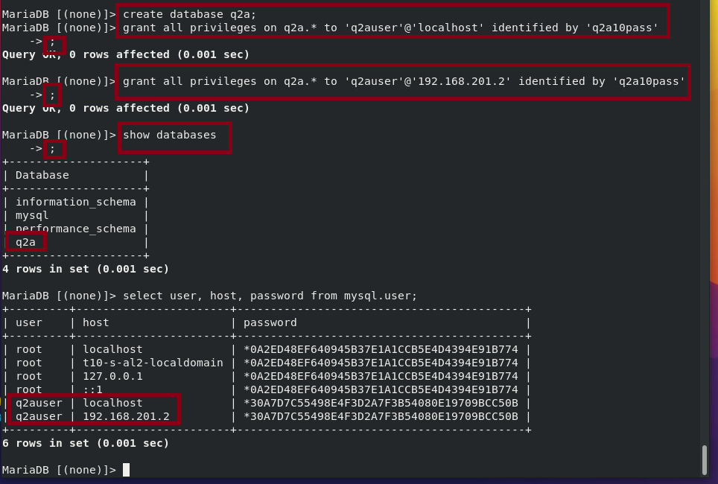
Create a new database call q2a and create q2auser with passwords and privileges.
create database q2a;
grant all privileges on q2a.* to 'q2auser'@'localhost' identified by 'q2apass';
User from DMZ zone:
grant all privileges on q2a.* to 'q2auser'@'192.168.201.2' identified by 'q2apass';
See results:
show databases;
select user, host, password from mysql.user;

Slide 12
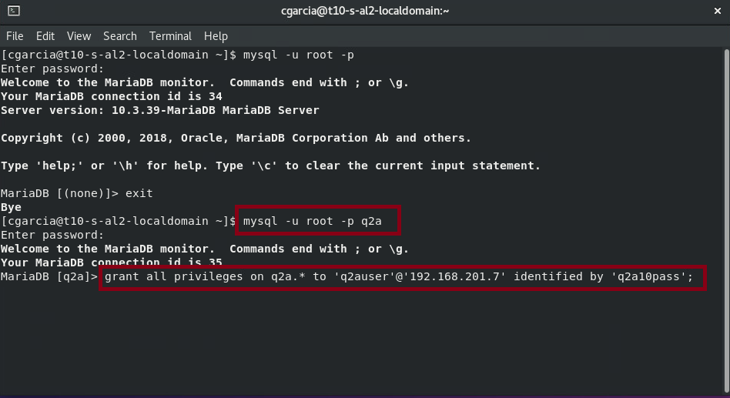
Create another user in the right machine.
mysql -u root -p q2a
grant all privileges on q2a.*
to ‘q2auser’@’192.168.201.7’
Identified by ‘q2a10pass’;
This shows how to create new users and
Add privileges to connect from other
machines.

Slide 13
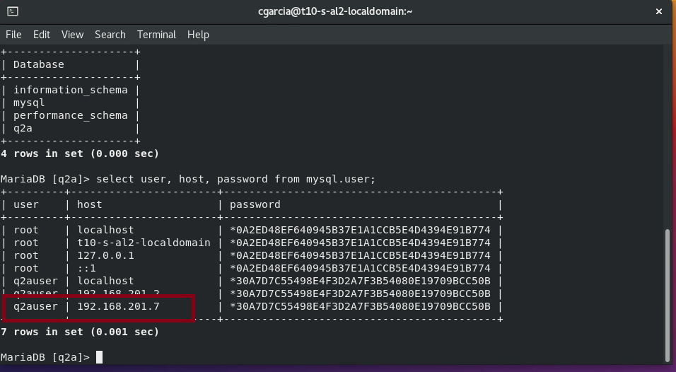
The new user created previously shows in the database.
select user, host, password from mysql.user;

Slide 14
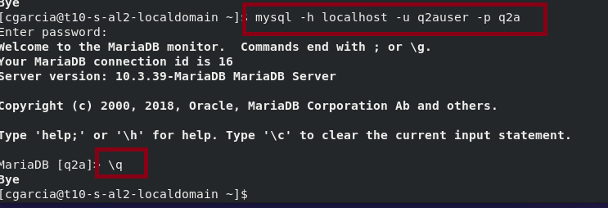
Connect locally to the q2a database as q2auser
mysql -h localhost -u q2auser -p q2a

Slide 15
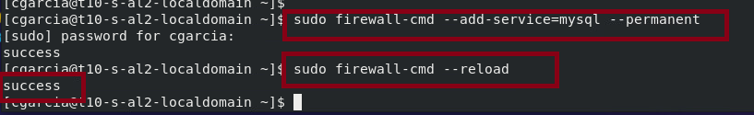
The following adjustments will allow other hosts to connect to MariaDB:
sudo firewall-cmd --add-service=mysql --permanent
sudo firewall-cmd --reload

Slide 16
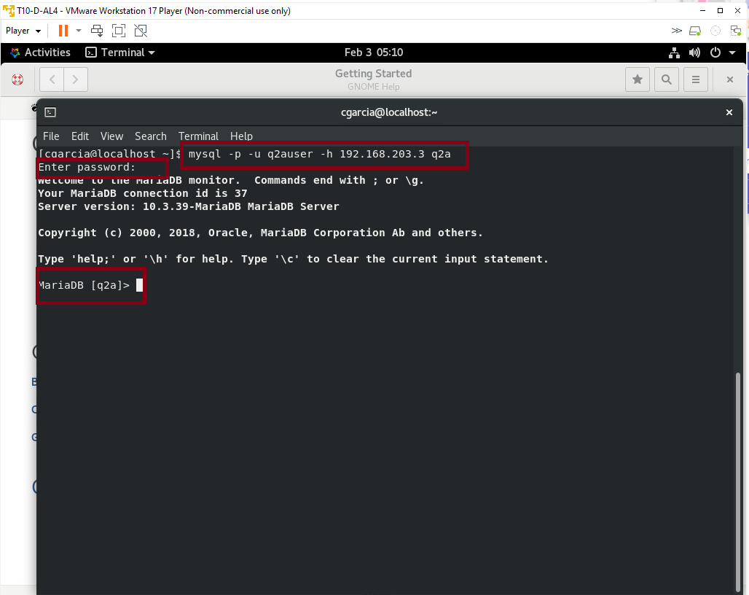
Remote connection from the DMZ machine where the apache server resides.
mysql -p -u q2auser -h 192.168.203.3 q2a
Description:
-p ask for password
-u username (q2auser)
-h host ip address(192.168.203.3)
(q2a) the name of the database

Slide 17
Apache server installation

Slide 18
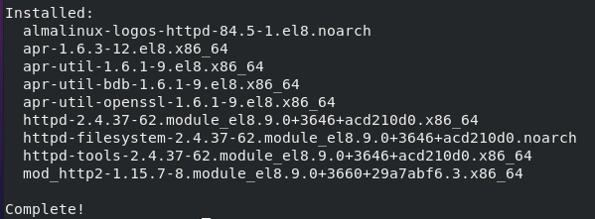
Install Apache Server
Download, install, and initialize Apache HTTPD server software.

Slide 19
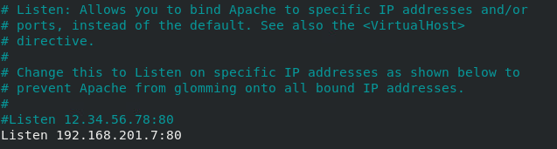
Install Apache Server
Backup a copy of the primary configuration file /etc/httpd/conf/httpd.conf
Change configuration file by changing the Listen directive to attach the service to the virtual ethernet. To do this open nano and change the Listener directive to the Host server IP address and port 80

Slide 20
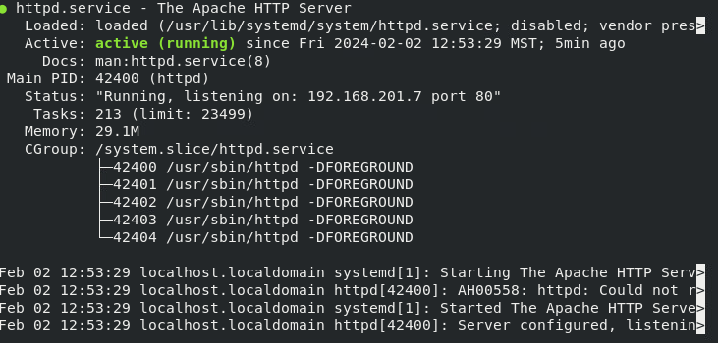
Install Apache Server
Check the server status.
Notice it is listening to the IP address and port we configured earlier.

Slide 21
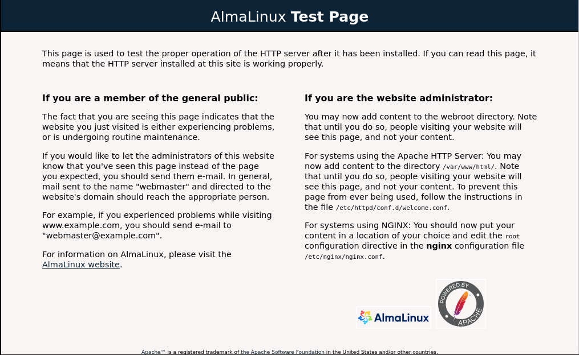
Install Apache Server
Enable service to start at startup.
Open browser and surf to the host servers webpage. You should see the new installation “Test Page”

Slide 22
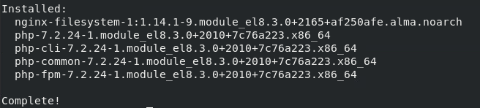
Download & Install PHP
Download and install PHP.
Restart Apache.

Slide 23
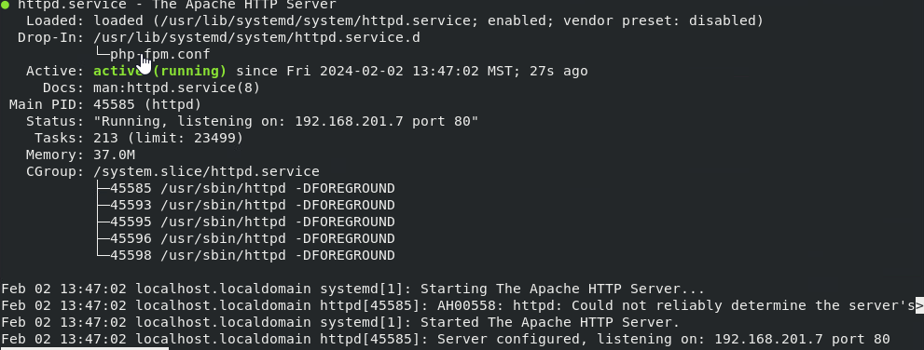
Download & Install PHP
Check Apache server status.
Notice php-fpm is activated without having to enable it.

Slide 24
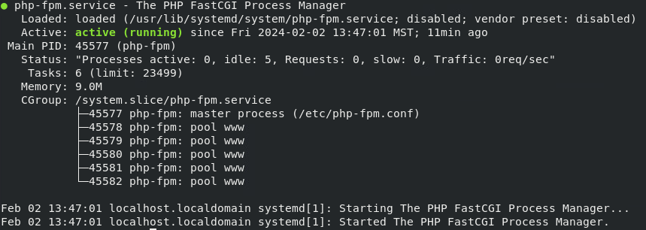
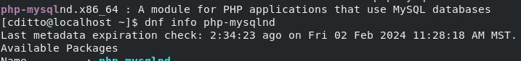
Download & Install PHP
Check php-fpm status.
In a later assignment Q2A will specify that we need to add the extension MySQLi but when we search for a MySQL extension we only find MySQLnd in Alma Linux.

Slide 25
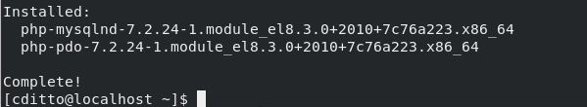
Download & Install PHP
MySQLnd is an updated extension from MySQLi. It is fine to use it in this installation. Install this package.

Slide 26
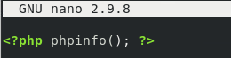
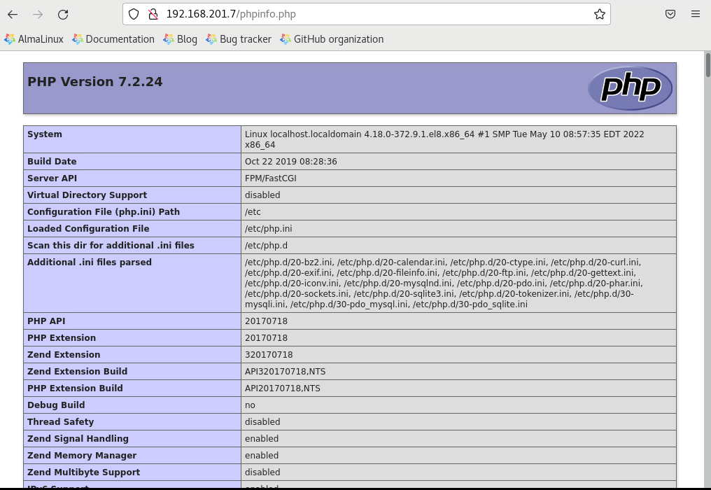
Test the PHP Installation
Create a PHP file in the Apache documentroot folder /var/www/html
Add the line <?php phpinfo(); ?> to the file.
Use the web browser to surf to that file, using the URL http://<DMZ server IP address>/phpinfo.php

Slide 27
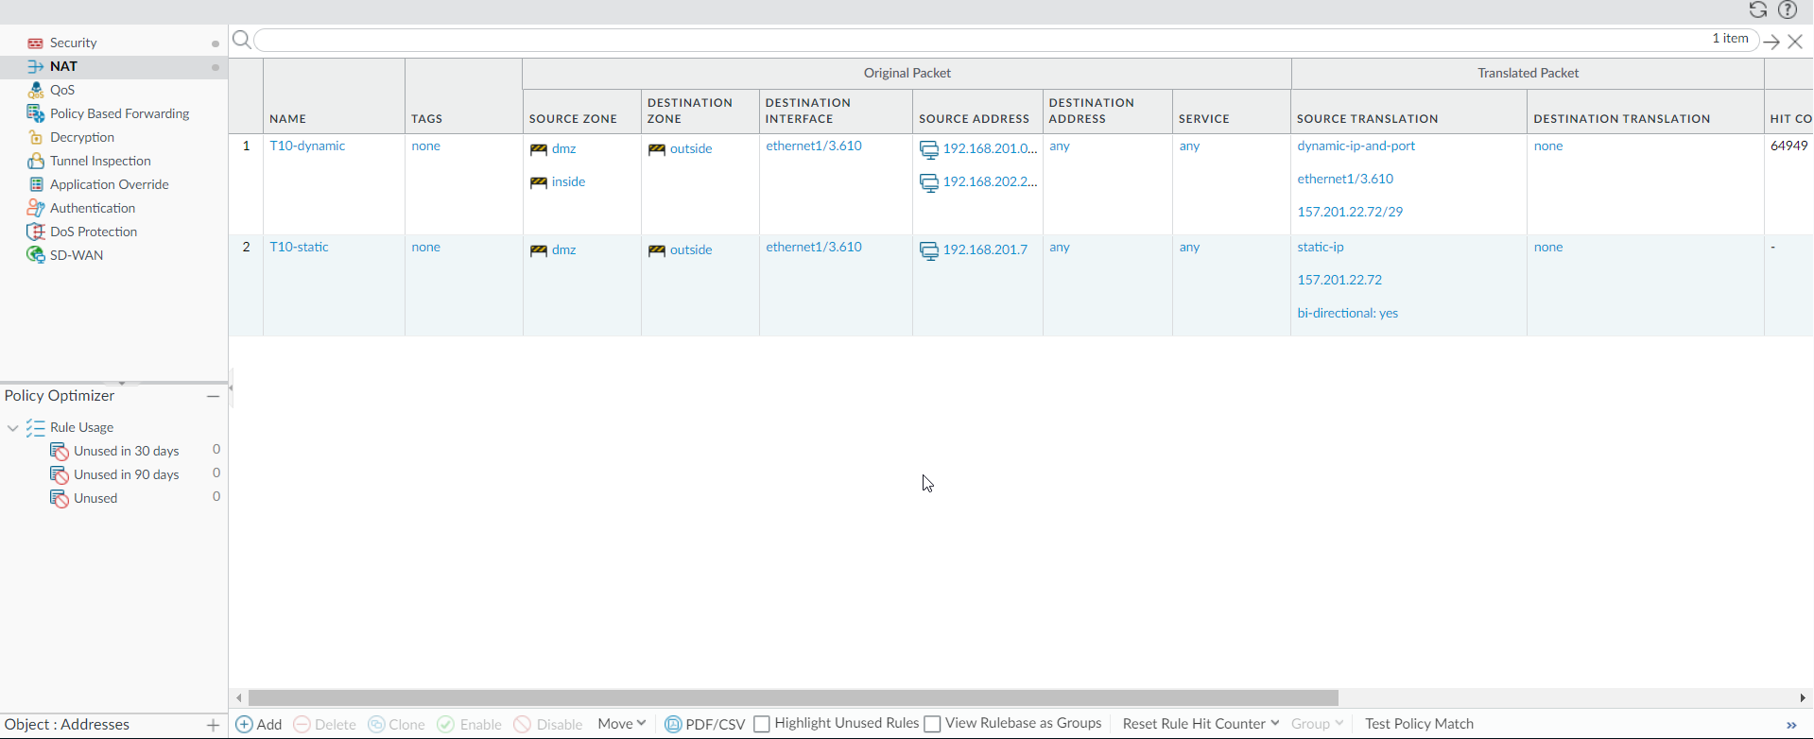
Configure Policies on Internet Facing Firewalls
Configure Static NAT.
Under the “Policies” tab, select “NAT” and then select “ADD”

Slide 28
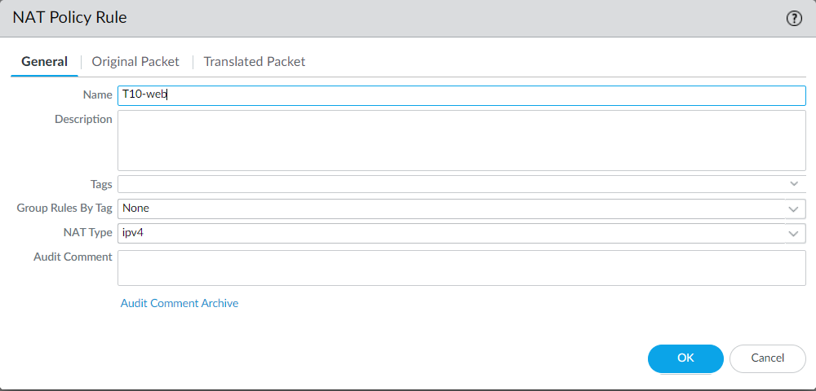
Configure Policies on Internet Facing Firewalls
Add a name to your NAT policy.

Slide 29
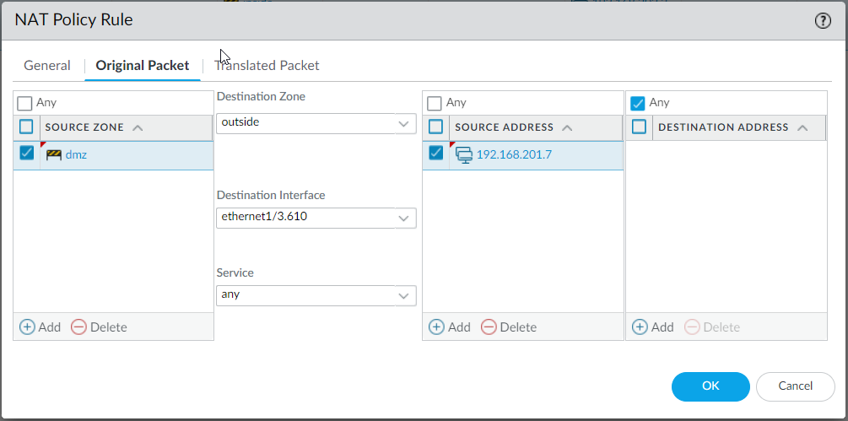
Configure Policies on Internet Facing Firewalls
Select the “Original Packet” tab.
Change the “Source Zone” to DMZ.
Select the dropdown in the “Destination Zone” Select outside.
Select the dropdown for the “Destination Interface” then select the VPN interface in the outside zone.
Under “Source Address” add the IP address of the apache server.

Slide 30
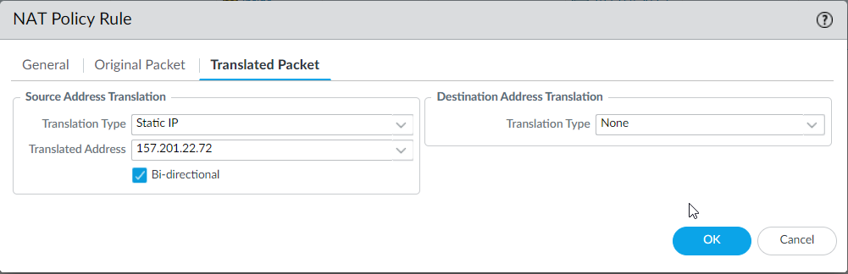
Configure Policies on Internet Facing Firewalls
Select the “Translated Packet” tab.
Under “Translation Type” select the dropdown and then Static IP.
Under the “Translated Address” enter the public IP address.
Check th “Bi-directional box” so the rule translates both ways.
Click “OK”

Slide 31
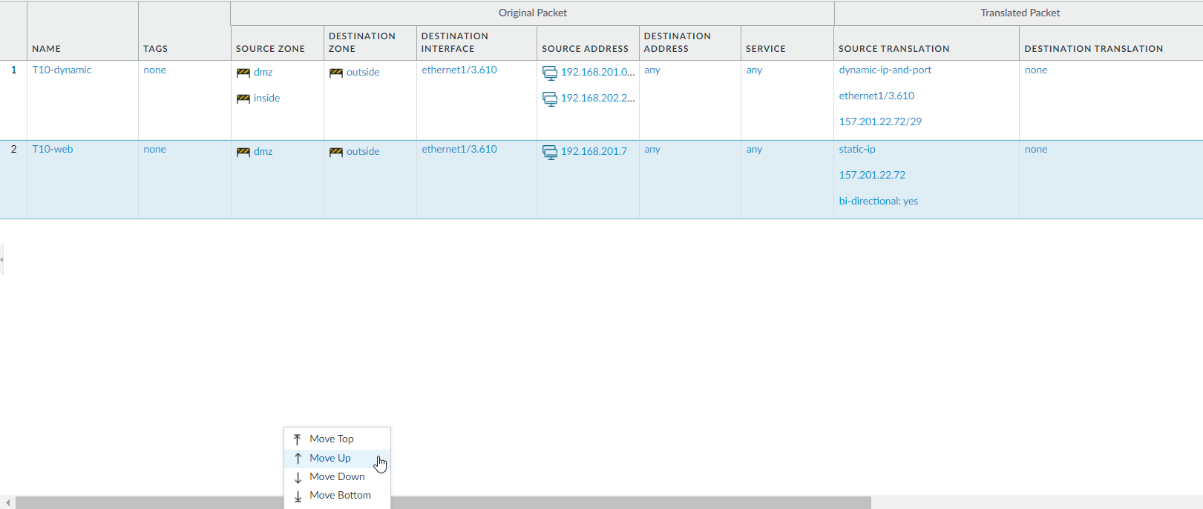
Configure Policies on Internet Facing Firewalls
Highlight the new rule and select “move up” from the “Move” interface at the bottom of the web-interface.
The rule needs to be before the team’s Dynamic rule.

Slide 32
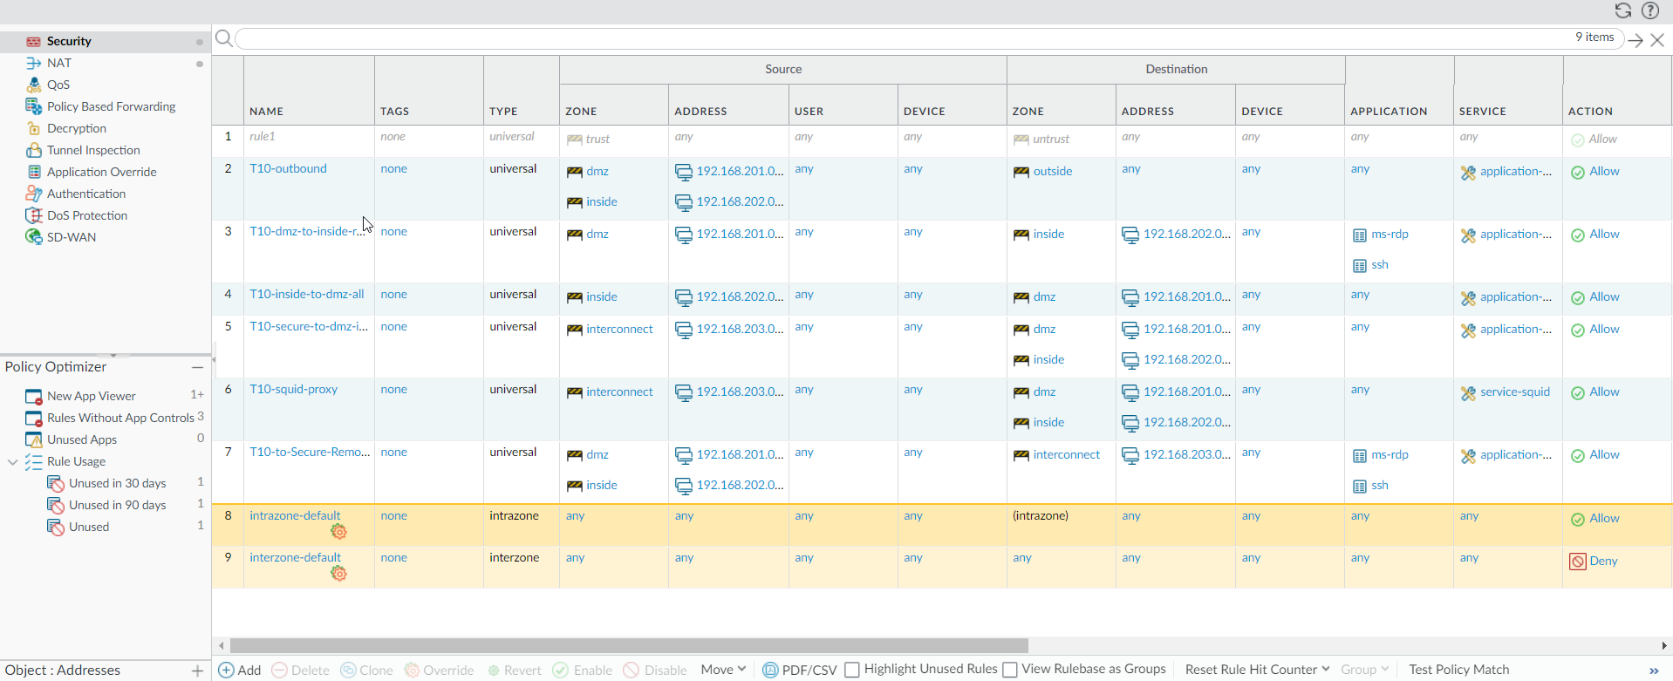
Configure Policies on Internet Facing Firewalls
Configure a web-server security policy.
Select Security on the left just above NAT then click on Add.

Slide 33
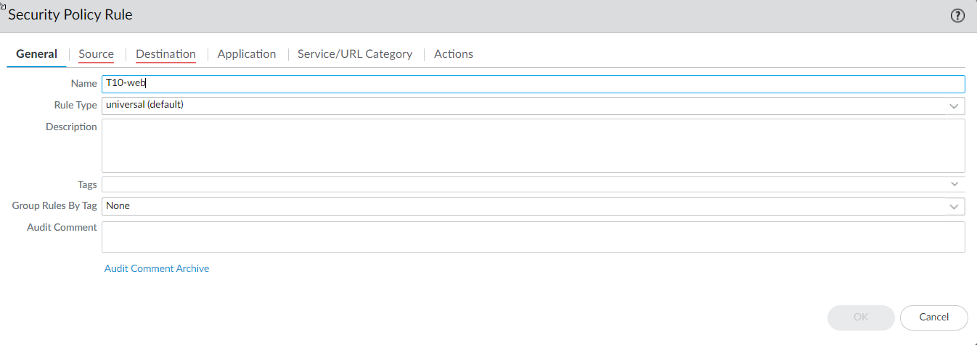
Configure Policies on Internet Facing Firewalls
Under General add the team name followed by “web” under the “Name” selection.

Slide 34
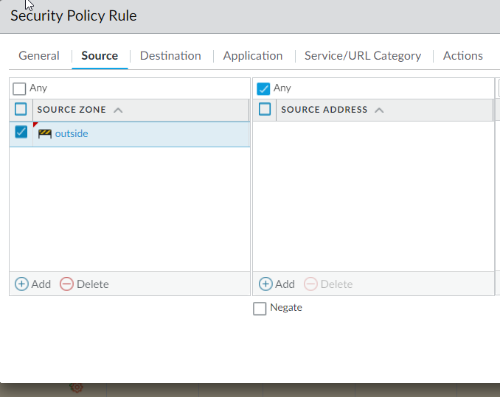
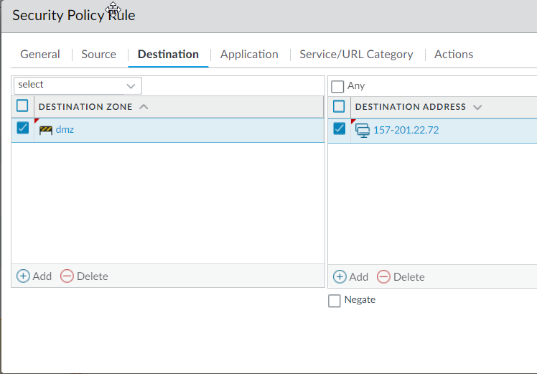
Configure Policies on Internet Facing Firewalls
Select the “Source” tab.
Under the “Source Zone” click on “Add” then select “outside”.
Select the “Destination” tab
Under the “Destination Zone” Select “Add” then select outside.
Under “Destination Address” add the public IP address of the web server.

Slide 35
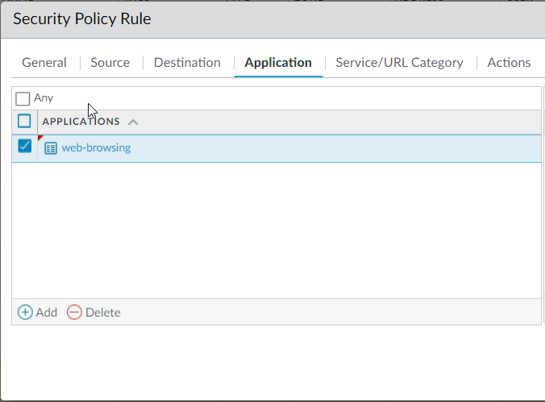
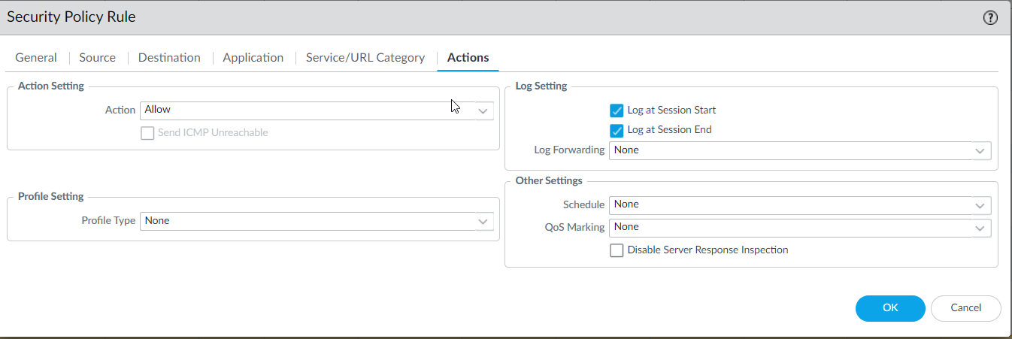
Configure Policies on Internet Facing Firewalls
Select the “Applications” tab, and specify web-browsing.
Select the “Actions” tab
Commit your changes.

Slide 36
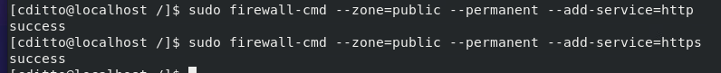
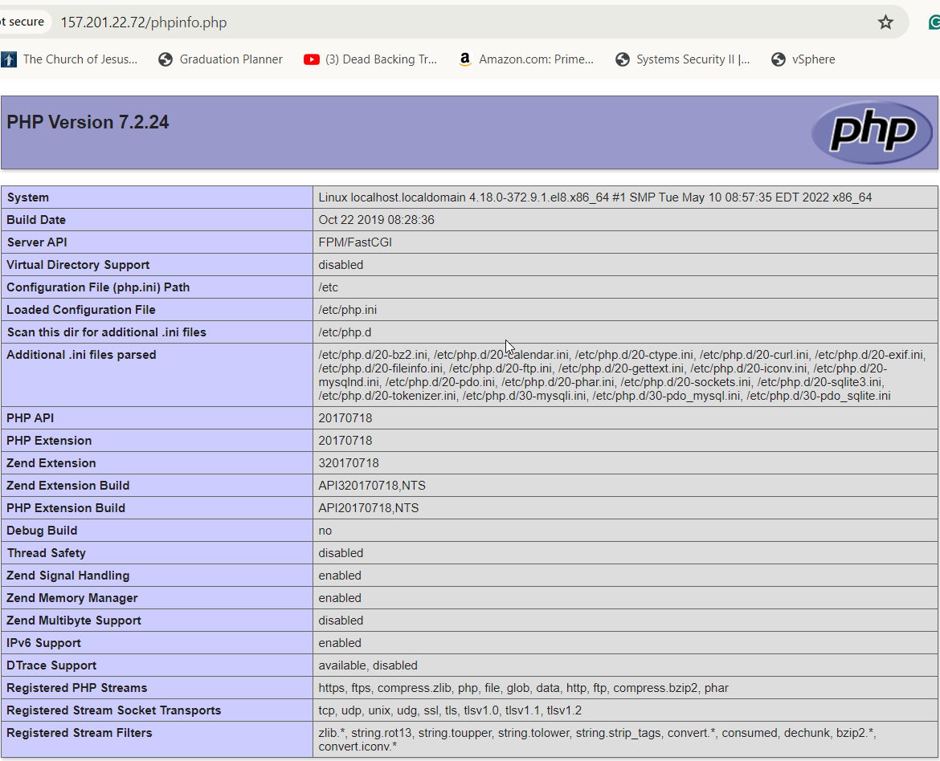
Configure Policies on Internet Facing Firewalls
Configure Apache server to accept HTTP and HTTPS requests through the firewall.
Enter http://<web server's public IP address>/phpinfo.php.
You should see the same info page that you saw at the in of the PHP test section of this instruction sequence.

Slide 37
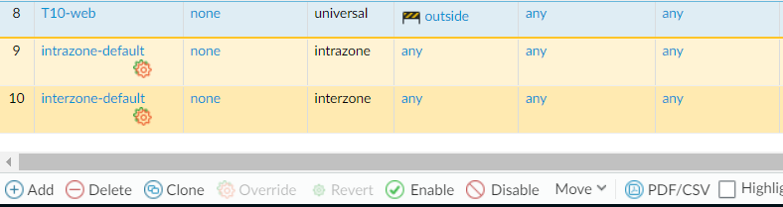
Configure Policies on Internet Facing Firewalls
Until the Question2Answer web app is installed and configured, it is a bad idea to leave the web server exposed to untrusted connections. Disable T10-Web rule until after the installation and configuration.
Highlight the T10-web rule then click “Disable” at the bottom of the web display.
Commit the change.

Slide 38
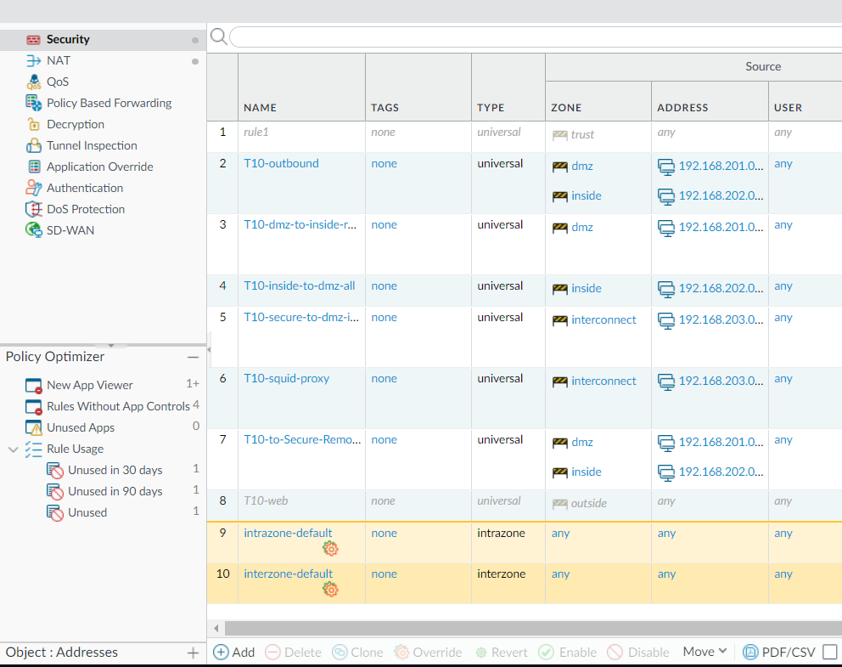
Q2A Internet-Facing Firewall Configuration
Check to make sure that qtauser can log into MariahDB.
This will result in an error until secure-facing firewall is configured.
Create a rule on the Palo Alto firewall that allows the application mysql from the web server in the DMZ through to the interconnect zone.
On the top left of the web display click on “Security” and then select “Add” at the bottom of the display

Slide 39
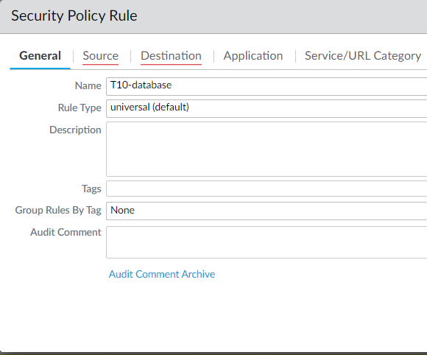
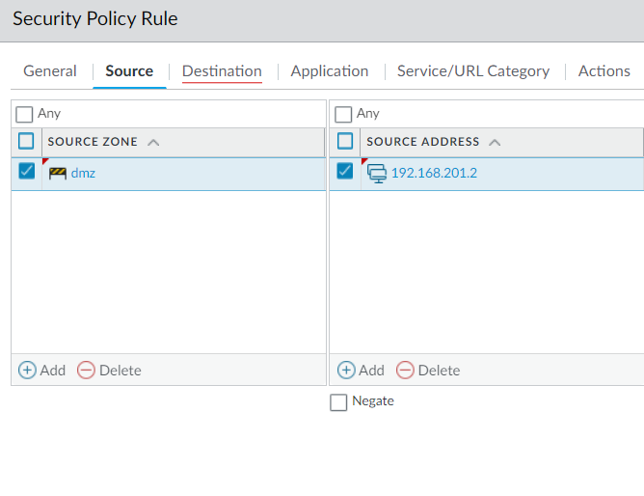
Q2A Internet-Facing Firewall Configuration
Under the General tab select Name and enter your (team’s name)-database.
Select the “Source” tab.
Under Source Zone Click on “Add” and then select DMZ.
Under Source Address Select “Add” then add the address of your teams DMZ web server.

Slide 40
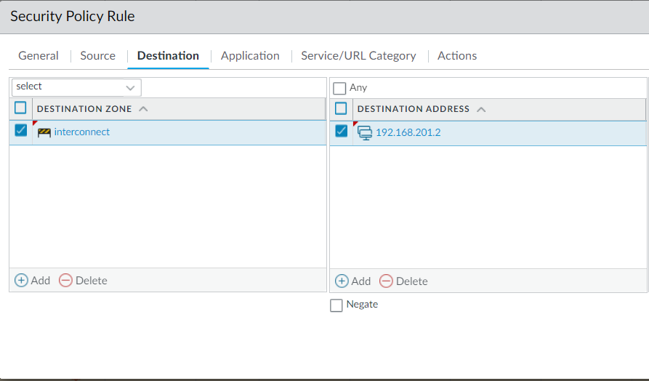
Q2A Internet-Facing Firewall Configuration
Select the “Destination” tab.
Under the Destination Zone, click “Add” then select “interconnect.
Under Destination Address, click “Add” then enter the IP address to your team’s DMZ web server.

Slide 41


Q2A Internet-Facing Firewall Configuration
Select the Application tab.
Under “Applications”Click “Add” then select “mysql”.
Select the Actions tab.
Make sure the Action setting is set to “Allow” and check the “Log at Session Start check box.
Click OK and Commit your changes.

Slide 42


Q2A Secure-Facing Firewall Configuration
Login to FortiGate.
Select “Firewall Policy” from the right side menu.
Click “Create New”.
Name the new rule “database”.
Under Incoming Interface select “Interconnect”
Under Outgoing Interface select (Team number)-secure Under Service select “mysql”.

Slide 43



Q2A Secure-Facing Firewall Configuration
For the Source and Destination selections you must create two new address objects.
Select the Source selection window then select “Create”.
Select “Address”.
Enter “dmz-web” for the name.
Enter the IP address of the team’s DMZ and subnet.
Click OK.
Repeat steps for the Destination selection.

Slide 44


Q2A Secure-Facing Firewall Configuration
Click OK.
Disable NAT

Slide 45

Q2A Installation & Configuration
Login to the web server in the DMZ and check that you are able to connect to MariaDB located on the Secure zone host.

Slide 46




Q2A Installation & Configuration
Open the browser on the Apache server and download the Question2Answer package from the Question2Answer website.
Extract the file into the downloads folder.
Rename the top file something easier like q2a.

Slide 47


Q2A Installation & Configuration
Open the q2a folder and change the names on the example files as per the instructions on the Question2Answer website.
There is a hidden example file as well you will need to change.

Slide 48


Q2A Installation & Configuration
There is a hidden example file as well you will need to change.
Select the hamburger on the top right corner and check the box show hidden files. Now remove example from the filename.

Slide 49


Q2A Installation & Configuration
Open the config file and
Scroll down to the PHP code that defines the database configuration file.
Change the settings to fit your teams database IP, username, password, and database name..
Save your changes by clicking save in the top right corner.

Slide 50
Q2A Installation & Configuration
Move the Question2Answer files to the web server’s “DocumentRoot” folder using the following commands. The last two commands move the hidden files we explored earlier.

Slide 51

Q2A Installation & Configuration
In the web server’s “DocumentRoot” folder, remove the index.html file so that the web server will serve the Question2Answer’s index.php code instead.

Slide 52


Q2A Installation & Configuration
The Q2A files that were moved from the download directory to the html directory were automatically labeled when they were placed in the download folder. These files need to be restored to the correct labels based on the context of where they reside in the file system.

Slide 53

Q2A Installation & Configuration
In this app, PHP uses json.
Download json to the machine.
Restart the machine so the PHP engine will notice its new functions.

Slide 54


Slide 55

Q2A Installation & Configuration

Slide 56

Q2A Installation & Configuration

Slide 57

Q2A Installation & Configuration
Q2a page open in windows system in the DMZ zone

Slide 58

Q2A Installation & Configuration
Q2a page open in Linux system in the DMZ zone. This system is the one that host the apache server.

Slide 59
Q2A Installation & Configuration
Restrict access to phpinfo.php .
Since we expose our app to the untrusted internet before we restrict access using chown command .
sudo chown -R /var/www/html/phpinfo.php

Slide 60

Q2A Installation & Configuration
Enable the web browsing rule to test the internet connection from outside. Remember to commit the changes after enable the rule.

Slide 61

Q2A Installation & Configuration
Access the q2a from a computer outside our network. Use the browser and put the outside address, in this case: 157.201.22.72

Slide 62
HAProxy load balancer configuration

Slide 63

Cloning the machine that holds the apache server.
Before start, power off the machine that will be cloned.
Use actions tab in sphere to get to the clone options menu.

Slide 64

Cloning the machine that holds the apache server.
From now on follow the indications in the screen.
First select a name and a folder were the machine will reside. Press next.

Slide 65

Cloning the machine that holds the apache server.
Select a computer resource, in our class the assigned for our class. Press next.

Slide 66

Cloning the machine that holds the apache server.
Select the storage and click in same format as source. Press next.

Slide 67

Cloning the machine that holds the apache server.
On clone options select power on virtual machine after creation.Press next.

Slide 68

Cloning the machine that holds the apache server.
Review and press finish.

Slide 69

Cloning the machine that holds the apache server.
Change the ip addresses to the new machine address.

Slide 70

Cloning the machine that holds the apache server.
Change the name to the correct new name.

Slide 71

Configuring the app in the cloned machine.
When trying to connect to the server in the cloned machine we cannot.

Slide 72

Configuring the app in the cloned machine.
We has to edit the configuration file to put the new listening address. The file we has to update is httpd.conf. We use the following commands:
change to the directory:
cd /etc/httpd/conf
edit the file with vi and change the Listen address.
sudo vi httpd.conf
restart the service to apply the changes.
systemctl restart httpd

Slide 73

Configuring the app in the cloned machine.
We get this new message because the mariadb database is not yet configured to connect with this machine.

Slide 74

Configuring the app in the cloned machine.
In the secure zone machine that host the mariadb we must configure the access from the new server. The first command give access as root to the database:
mysql -u root -p

Slide 75

Configuring the app in the cloned machine.
To give access use the following command:
grant all privileges on q2a.* to q2auser’@’192.168.201.9’ identified by ‘q2a10pass’;
Then you can use the following command to check the result:
select user, host, password from mysql.user;
In the last line appears the new access.

Slide 76

Configuring the app in the cloned machine.
Remember to flush those privileges:
flush privileges;

Slide 77

Configuring the app in the cloned machine.
We has to give access also in the Firewalls. On the Palo Alto policies add the new address to the rule to allow mysql from the dmz zone. In policies select the rule, and in the source tab add the new address. Don't forget to commit your changes.

Slide 78

Configuring the app in the cloned machine.
Then to add access in the Fortigate, opened from a machine in the secure zone create a new address object to add to the rule that allows connections from the DMZ.In Policy & Objects tab, select Addresses, and the Create New tab.

Slide 79

Configuring the app in the cloned machine.
Then create the new address as the one created before to allow connections for the other machine and press OK.

Slide 80

Configuring the app in the cloned machine.
Then select Firewall Policy tab and select the database rule by clicking into that line. Then select Edit.

Slide 81

Configuring the app in the cloned machine.
A Edit Policy interface will be open and in the line of the Source select the + sign that opens another tab with a list. In that list select the new address (dmz-web2) that you created and finish with OK.

Slide 82

Configuring the app in the cloned machine.
This is how it should looks at the end. If the line still is colored , just reload the page with the option at the bottom of the creen, and it should look as in the picture.

Slide 83

Configuring the app in the cloned machine.
Now from any machine on the dmz zone you are able to start the app with the address of the new machine.Then, the app is working as it should from the DMZ zone now in the new cloned machine.

Slide 84


Configuring a load balancer in Alma Linux T10-D-AL3.
We have an extra machine created for testing purposes that is up and ready to install software, then we will use this machine. In case a new machine were necessary, refer to the first presentation on installing VM’s.
Here you can see the machine settings for connectivity.

Slide 85

Configuring a load balancer in Alma Linux T10-D-AL3.
Since I already have internet connectivity, I first upgrade and update the system to start with the last version and patches.
we used:
sudo dnf upgrade almalinux-release
sudo dnf update

Slide 86


Configuring a load balancer in Alma Linux T10-D-AL3.
Here are the commands to find install and examine haproxy in alma linux.
dnf search haproxy
sudo dnf -y install haproxy
rpm -ql haproxy

Slide 87

Configuring a load balancer in Alma Linux T10-D-AL3.
The configuration file /etc/haproxy/haproxy.cfg usually contains a demo config, which we won’t use. For best-practices sake, make a backup of the config:
cd /etc/haproxy
sudo cp haproxy.cfg haproxy.cfg.orig

Slide 88

Configuring a load balancer in Alma Linux T10-D-AL3.
Edit the file with vi:
sudo vi haproxy.cfg
Find and delete all of the “frontend” and “backend” configuration stanzas, and replace them with a frontend and backend suitable to balance your original and cloned web servers.
frontend q2aWeb
bind 192.168.201.5:80
default_backend q2aBack
backend q2aBack
balance roundrobin
server T10-D-AL4 192.168.201.7:80 check
server T10-D-AL5 192.168.201.9:80 check
This configure round robin in our balancer, haproxy will listen for connections in this system and forwarder taking turns to each of the servers.

Slide 89

Configuring a load balancer in Alma Linux T10-D-AL3.
As all new services starts being disabled and inactive, we use this commands to check and start the service:
systemctl status haproxy
sudo systemctl enable haproxy
sudo systemctl start haproxy
systemctl status haproxy

Slide 90


Configuring a load balancer in Alma Linux T10-D-AL3.
Is possible that you get this screen after all configurations are done. To solve this problem we has to configure the firewall in the balancer host machine to allow the http service with:
sudo firewall-cmd --add-service=http --permanent
sudo firewall-cmd --reload

Slide 91


Configuring a load balancer in Alma Linux T10-D-AL3.
Now we can access the app through the load balancer in the ip 192.168.201.5
Here you can see access from the load balancer host and from another endpoint in the dmz.

Slide 92



Test HAProxy, and verify that is balancing properly.
In the Palo Alto firewall we will adjust the rule to give clients in the internet to access the app. We are opening the balancer machine to untrust areas.
On NAT select the T10-web rule and change the source address to point to the load balancer hosting machine by selecting the address and change the address in the window that pop up. Remember to commit the changes.

Slide 93

Test HAProxy, and verify that is balancing properly.
Now the app is accessible from the internet through the load balancer that alternate the servers use.
Now we explore several ways to test that this is occurring.

Slide 94





Test HAProxy, and verify that is balancing properly.
First option is use rsyslog to collect logs of the service.
Check that rsyslog is working:
systemctl status rsyslog
Find his configuration file
rpm -ql rsyslog | less
Edit his configuration file with vi and uncomment this lines:
sudo vi /etc/rsyslog.conf
#module(load="imudp")
#input(type="imudp" port="514")
Then restart the service and check on the logs.
sudo systemctl restart rsyslog

Slide 95

Test HAProxy, and verify that is balancing properly.
With the previous configuration one can see the logs generated by the app with this command. The request take turns in each server.You can see machines al4 and al5 alternate.
sudo tail /var/log/messages

Slide 96


Test HAProxy, and verify that is balancing properly.
As a good practice we will redirect the logs to a separate file. We edit again the configuration file:
sudo vi /etc/rsyslog.conf
Find this rule:i
*.info;mail.none;authpriv.none;cron.none /var/log/messages
And change it to:
*.info;mail.none;authpriv.none;cron.none;local2.none /var/log/messages
And add a new rule that sends local2 facility to haproxy.log
local2.* /var/log/haproxy.log
As before save and restart the service will apply the changes.
sudo systemctl restart rsyslog

Slide 97

Test HAProxy, and verify that is balancing properly.
There are 2 optional ways to check the alternate of the servers on this task. Today I will leave here. If you feel to continue are welcome. Look ar the end of the class tutorial where stay optional.

Slide 98
Challenges we faced

Slide 99

If mariadb is not running use the following commands.
Use the command sudo systemctl status mariadb to look if is enable and had start. If not use the same command changing to enable and start, to start the service.

Slide 100

We experienced connections problems from the DMZ with the database in the secure zone.
We used wireshark to test why we didn't have app connections between the DMZ and the secure zone. The firewall was already configured with a policy to allow mysql.

Slide 101

Connections problems from the DMZ zone.
Filtering our capture from Wireshark on the apache DMZ machine we saw that the packages were send but somehow not receiving responses. Black color is an indicator of something not working in the connections.

Slide 102

In the Palo Alto firewall the packages were dropped, and not allowed.
Checking in the Palo Alto monitor tab and filtering between the 2 address that we were interested in, we find some dropped packages when trying the connections.
Then we review the policy and found that was disabled.
After enable and commit it start to work again. See next slide.

Slide 103

The allow policy to mysql from DMZ to secure working.
Is always good to know where to find the tabs to enable or disable a policy to troubleshoot, and remember to commit changes.Here in policies tab and after highlight the rule that is grey (disabled), we use the bottom line tab enable to get it to the right blue color again. But remember that not change is done before we committed.

Slide 104

Results before and after the policy was enabled.
The packages now flow through the firewall as we can see in the monitor of the firewall.

Slide 105

After enable the firewall policy that allow transmission. Connections were established.
This is a screenshot of wireshark monitor that shows the reconnected status. Is filtered by the destination address 192.168.203.3

